Slide 1
Web Development
GROUP 24
Golla Ranga Kousik
Ajay kumar nagula

Slide 2
Contents in Mobile development
Development of a basic mobile application
Developed a pizza delivery app with multiple features
Created an application to make an API call and receive the data from the API

Slide 3
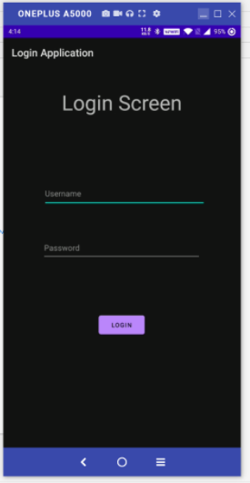
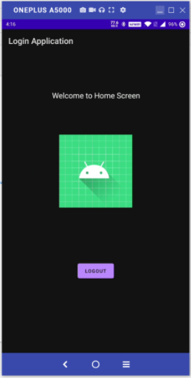
Login Page
Login page
Welcome page
AppCompatActivity: Base class for activities that desire to utilize some of the newer platform highlights on older Android gadgets
Android Bundle : To exchange the data among the activities.
EditText: A user interface element for entering and modifying text.
Attribute for hiding the password Android:inputType="textPassword"
Switching Between activities : Intent

Slide 4
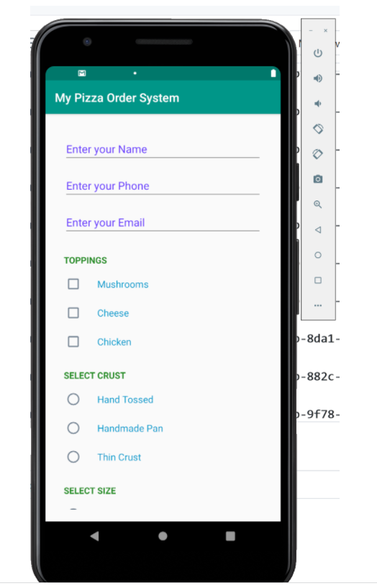
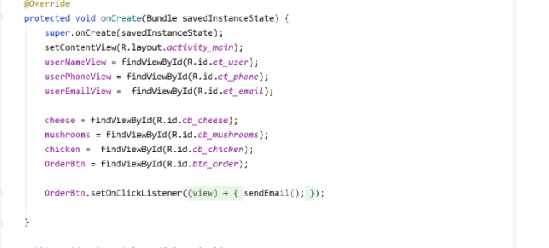
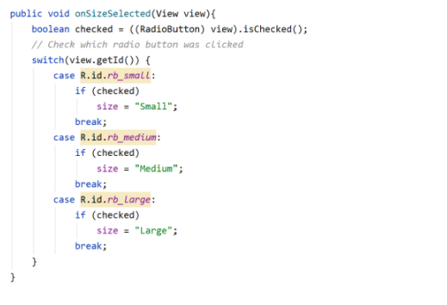
Pizza APP
Summary

Slide 5
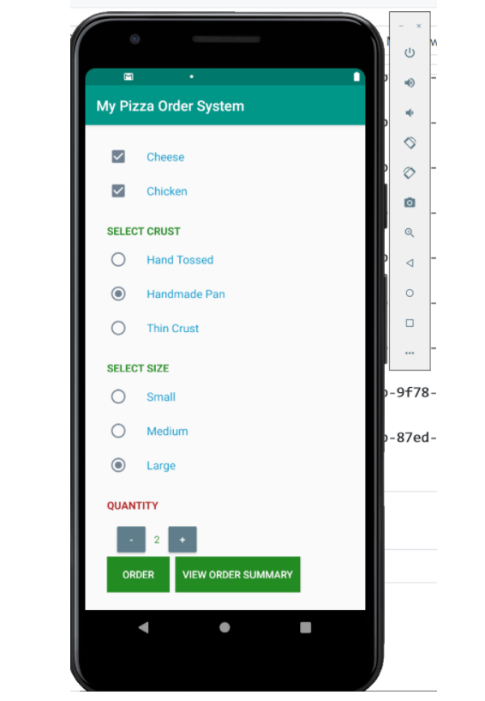
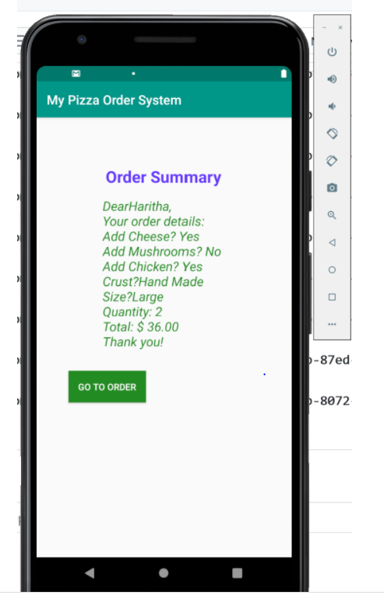
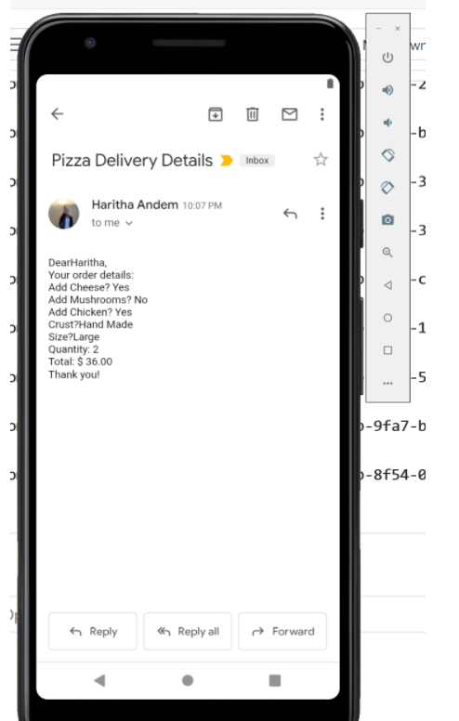
User Input
Mail compose
Mail received by the user

Slide 6
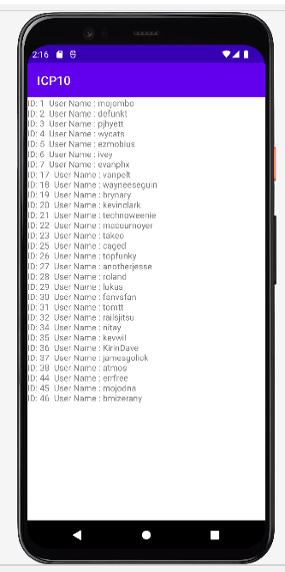
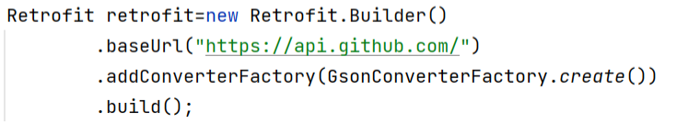
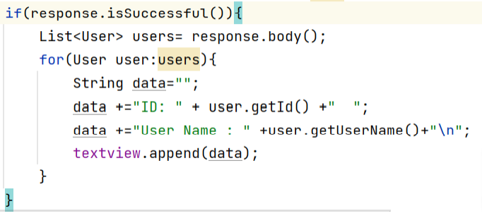
API calls with Andriod Studio
Retrofit: It manages the activities like sending, receiving, and creating the http requests &Responses.

Slide 7
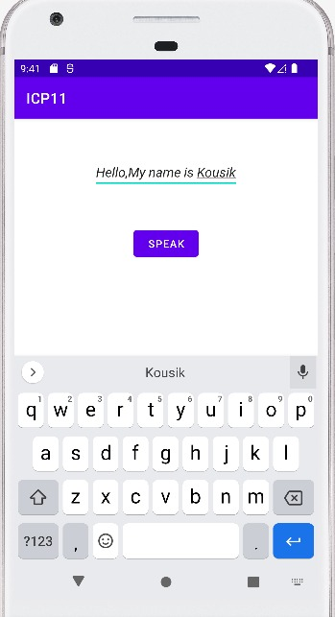
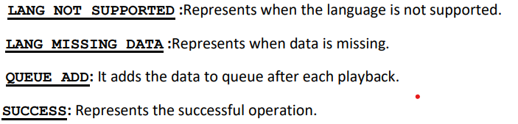
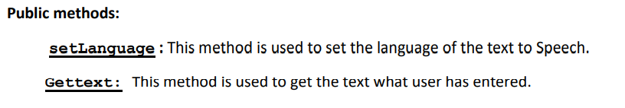
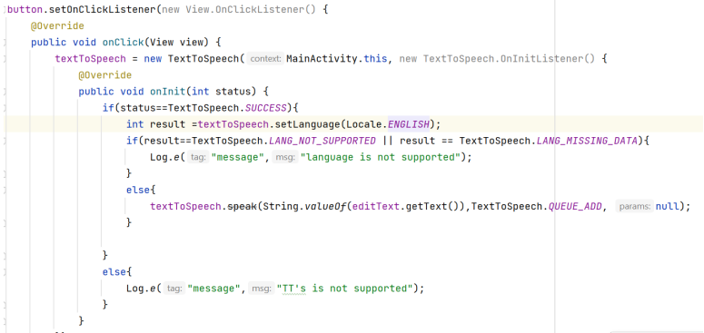
Text To Speech
We have a in-build class called Text to speech
Constants:

